Slide 1
What can DDI do for you? An introduction to the DDI
Monday November 30, 2020
Benjamin Beuster - NSD - Norwegian Centre for Research Data
Jane Fry – Carleton University
License: Creative Commons Attribution 4.0 International (CC BY 4.0)
Notes:
I am the Data Services Librarian at Carleton University in Ottawa and have been doing DDI for about 10 years,
And I will let Benjamin introduce himself when he starts.

Slide 2
Outline
The importance of Metadata
What is DDI?
What is the DDI Codebook?
What is the DDI Lifecycle?
What else?

Slide 3
Metadata
Source: https://bit.ly/35lPlIK
Notes:
First – a sidetrip
To understand the importance of DDI, you have to understand the importance of metadata first.

Slide 4
Source: https://bit.ly/2IvHGit
Notes:
I like to use food examples – everyone understands them!!!
Shout out to one of my colleagues, Michael Steeleworthy, for giving me this example. He uses it in his workshop and now I do also.

Slide 5
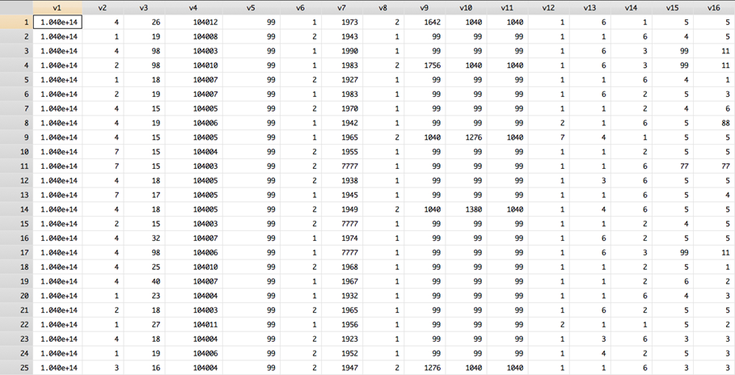
Copyright © GESIS Leibniz Institute for the Social Sciences, 2016
Notes:
Or in the case of data – how about this example?
I would like to give a shout out and a note of thanks to those who presented on DDI at the 2019 EDDI conference – Hilde, Benjamin and Taina – I have used many of their graphics here as they were too good not to!
So when you look at this slide, what do you think?

Slide 6
What is the study about? Who created it?
Mode of collection?
Who was asked? What is the population?
What was the data capture? (the question)
What is the meaning of the codes?
What was the previous question?
What do the variables mean?
What was the intent/concept of the question?
Who funded it?
Copyright © GESIS Leibniz Institute for the Social Sciences, 2016
Notes:
Note - this list of questions in the clouds here is not exhaustive.
End goal of metadata: For the audience to know what the survey is all about.
What you should think about is that if you need this information, then others will need it also.
For example - what is the meaning of the codes. In Canada there are 10 provinces and 3 territories. They are often coded with numbers and not characters. So if you see a number 10 in the geography variable, then you go to the metadata to tell you what the 10 stands for. Otherwise, you will not know that this particular value in the geography variable is for Ontario.

Slide 7
What is DDI?
DDI = Data Documentation Initiative
An international metadata standard
Used primarily in the social and behavioural sciences, economics, health
An open standard designed for data sharing and reuse
A structure for describing data and its related information
Describes data from surveys and other observation-based data collection methods
currently moving towards covering new data types and data from new domains.
Notes:
Metadata
-- be about the study – eg. what is it about – the abstract, who created it, who funded it, who was the population, what was the mode of collection
-- also gives information about the dataset – eg. what does this variable mean, what question was asked, was there a follow-up question, what are the values of this variable

Slide 8
DDI as a standard
The DDI standard structure means
all computers, even if they are using different applications, can work on the same data and related information (metadata/documentation)
Uses generic XML technology as the basis for cross-platform use
The format is not proprietary to any specific system
Notes:
This is where DDI comes in – puts the metadata in a structured format to help the data user find out everything about a survey that is available – as long as the information has been entered DDI

Slide 9
More information
DDI website
http://www.ddialliance.org/
Excellent resource
Learn (training materials)
Products
Events
Publications
Collaborate
About

Slide 10
DDI Alliance …
A self-sustaining member organization
Created in 2003
Members have a voice in DDI development
Executive Director
Jared Lyle
All information is on-line
Membership, Charter, by-laws, forms, …
Publications, conferences, working groups, …
http://www.ddialliance.org/about/about-the-alliance
Notes:
contact - Jared Lyle, DDI Alliance Director (since 2015)
If you are planning on implementing DDI in your institution, you should look into the DDI Alliance. Being part if it means being able to give input when they are discussing changes, edits, new formatting, …

Slide 11
DDI Alliance
Organization consists of
Executive Board - The policymaking and oversight body of the Alliance.
Scientific Board - Responsible for the work to develop the standard.
Technical Committee - To maintain the various DDI products, in collaboration with the different working groups of the DDI Alliance.
Working Groups - Convened to work on different activities and topics within the work areas of the DDI Alliance.
Notes:
WGs – currently there are 6 or them

Slide 12
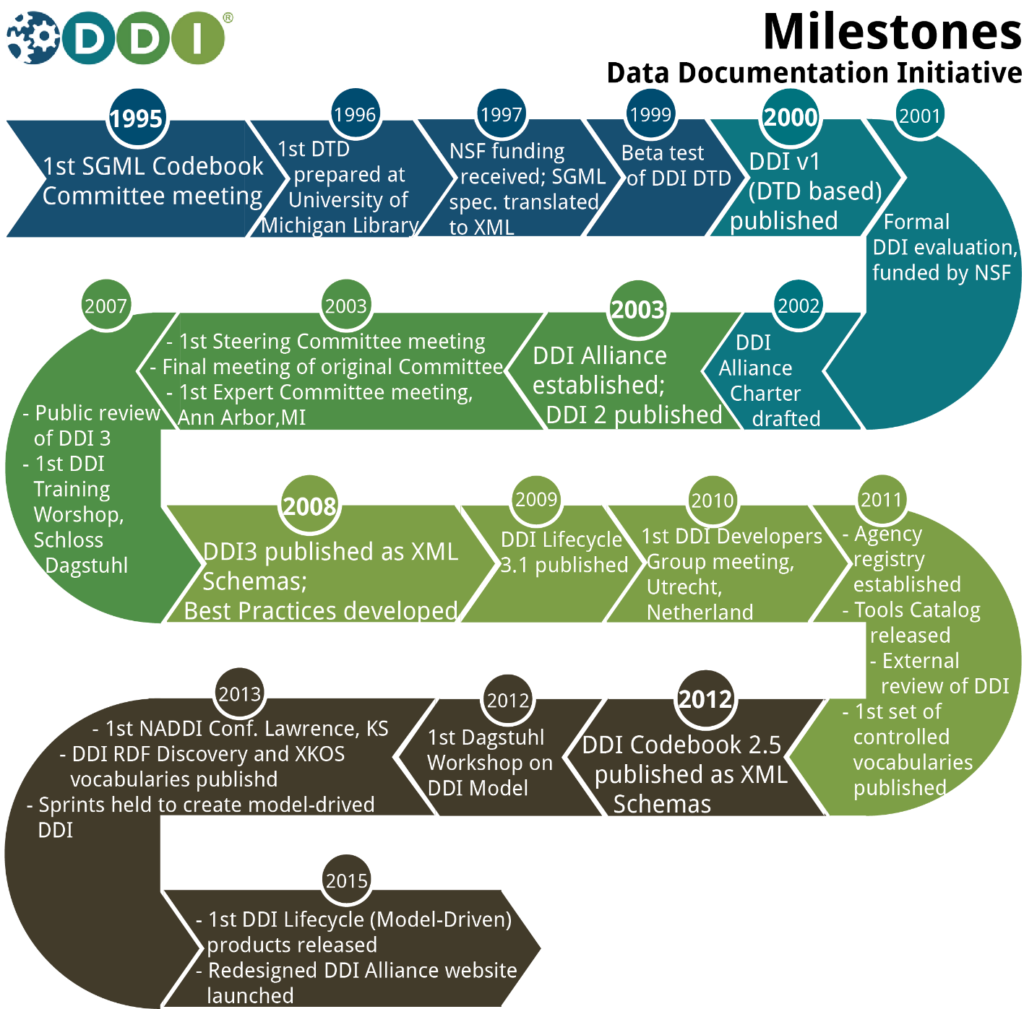
http://www.ddialliance.org/what/history.html

Slide 13
Why Use DDI?
“DDI encourages comprehensive description of data for discovery and analysis and supports effective data sharing. Because DDI is a structured standard, it facilitates machine-actionability and interoperability and it can actually be used to drive systems. Another feature of DDI is its focus on metadata reuse; “enter once, use often” means you can reuse metadata over the course of the data life cycle to avoid costly duplication of effort.
Source: http://www.ddialliance.org/training/why-use-ddi
Notes:
So let’s just review

Slide 14
Benefits of DDI
Interoperability
Rich content
Granular
Expansive
Increased search capability
Precision in searching
International community
Notes:
Interoperability – example – I mentioned XML earlier
XML – can be used for cross-platform use
Rich content – example - titles –subtitle – parallel title – alternative title

Slide 15
Challenges of DDI
Complexity
Level of researcher buy-in
Notes:
Complexity
For some people it is not intuitive to learn
Steep learning curve but there does come a point when it will seem like second nature to you
But the level of complexity you will be dealing with depends on the tool you will be using to interpret it
Low level of researcher buy-in
Primary goals for researchers are data and analyses not metadata
Metadata need to be perceived as essential part of research
They have to understand that high quality metadata in an accessible form is essential for the whole research process

Slide 16
Getting started with DDI
Daunting at first
Process is broken down into steps
Lots of help available
DDI Alliance
http://www.ddialliance.org/training/getting-started
Colleagues
Other researchers
DDI List-serv

Slide 17
Interpretation of DDI
Written in XML format
Need a tool to interpret it
Popular ones are
Nesstar
Colectica
Dataverse
More information: https://ddialliance.org/resources/tools
Notes:
When we talk about getting started, we have to talk about how to interpret DDI
Remember I mentioned that DDI needs a tool to interpret it when I was talking about the challenges of DDI?
That is what we are talking about now

Slide 18
…
Expressed in XML
The XML schema is a way of tagging text for meaning, not appearance
Defines
Which tags are available
The order the tags will appear in a document
Whether the tags are required or optional
Whether the tags are repeatable or not
Notes:
Tagging or markup follows certain established rules

Slide 19
Examples of DDI Tags
<titl>Canadian Community Health Survey, 2012: Annual Component </titl>
<labl>Questionnaire (.pdf)</labl>
<dataDscr><notes>The variables in this study are identical to earlier waves. </notes></dataDscr>
<titl>Canadian Gallup Poll, May 2000</titl>
<dataChck>Quality checks were performed by Carleton University Data Centre. </dataChck>
<titl>Survey of Household Spending, 2001 [Canada]</titl>
<varQnty>255</varQnty>
<titl>Canadian Gallup Poll, May 1949, #186</titl>
<copyright>Copyright Gallup Canada Inc., 1950</copyright>
Notes:
I put this slide in here to convince you that a tool is needed to interpret DDI
There are probably some here today that can read this but most likely not many.
I have bolded the parts that you would see when you use a tool to interpret DDI
You can see here examples of some of the tags that are used in DDI to define some of the metadata in a survey
- title, a note about the data, a note about the data check, number of variables

Slide 20
DDI users
Agencies
Projects
Norwegian Social Science Data Services
Harvard University
DLI (Statistics Canada)
Health Canada
Bureau of the Census
ICPSR
Bureau of Labor Statistics
ESRC Data Archive (UK)
Zentralarchiv für Empirische Sozialforschung (GESIS)
…
CESSDA Data Portal
Australian Social Science Data Archive
DAMES Project (UK)
DataFirst (at University of Cape Town)
Israel Social Science Data Center
ICPSR Data Catalog
ODESI (Canada)
Statistics New Zealand
…
Notes:
Now that we know what DDI is, let’s see who is using it.
Mentioned earlier that DDI has an international community

Slide 21
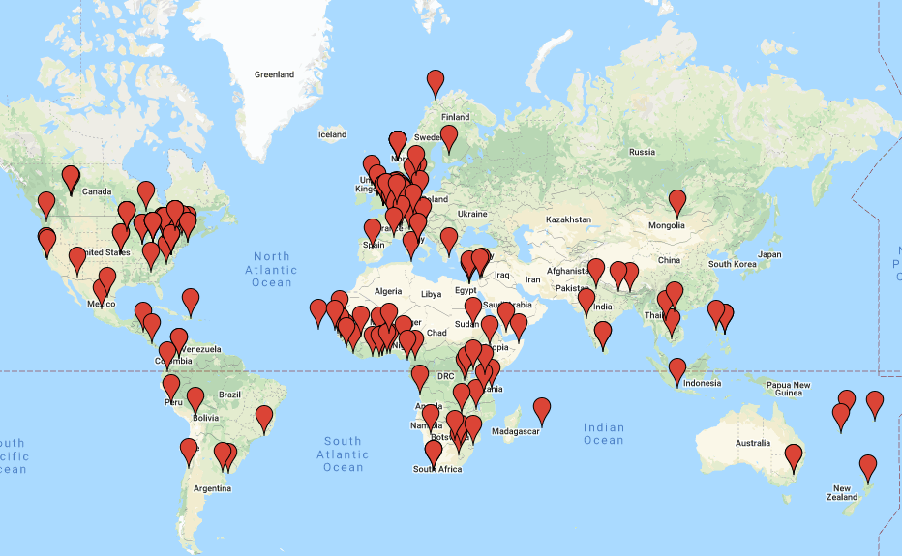
DDI Users in 2020
Source: https://ddialliance.org/community/join

Slide 22
DDI Audiences
Librarians
Managers
Repositories
Researchers
Developers
For more information, check out the DDI Alliance website
Notes:
Now that we know some of the agencies and projects that are using it, who are the audiences?

Slide 23
Caveat!
DDI is a powerful metadata standard provided that
the correct information is entered into the appropriate fields when marking up the document
Notes:
this point is very important – DDI has the power to help you if the correct information is entered into your tool of choice
If the information has not been entered in properly, you will not be able to find it and that is not the fault of DDI.
It would be like having a brand new car with no gas to get it going.

Slide 24
DDI Products
The DDI standard has developed over time
Continues to develop based on what users want
Currently has three main products
DDI Codebook
DDI Lifecycle
DDI CDI (forthcoming)
Each designed for a different purpose
Notes:
DDI CDI = Cross Domain Integration – there is a session on this right after this one that you can attend to find out more information

Slide 25
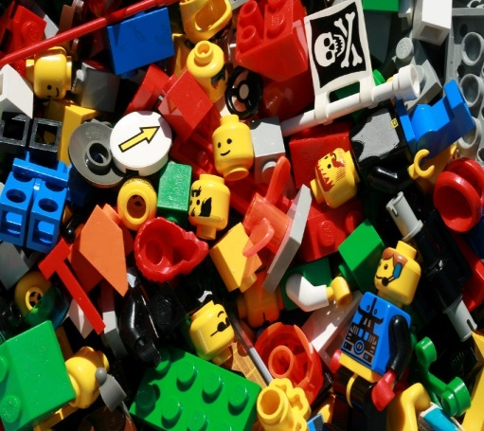
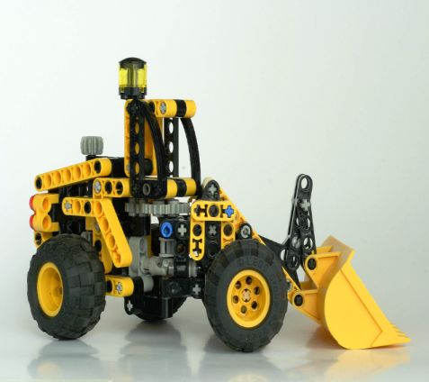
DDI Codebook
Metadata structured by DDI Codebook standard
Metadata not structured
DDI Codebook structures
Lost Metadata Manager
Notes:
**remember that I expressed my thanks earlier on to Hilde, Benjamin and Taina from EDDI 2019 for their slides? Well, all of these slides with Lego pictures are from them.

Slide 26
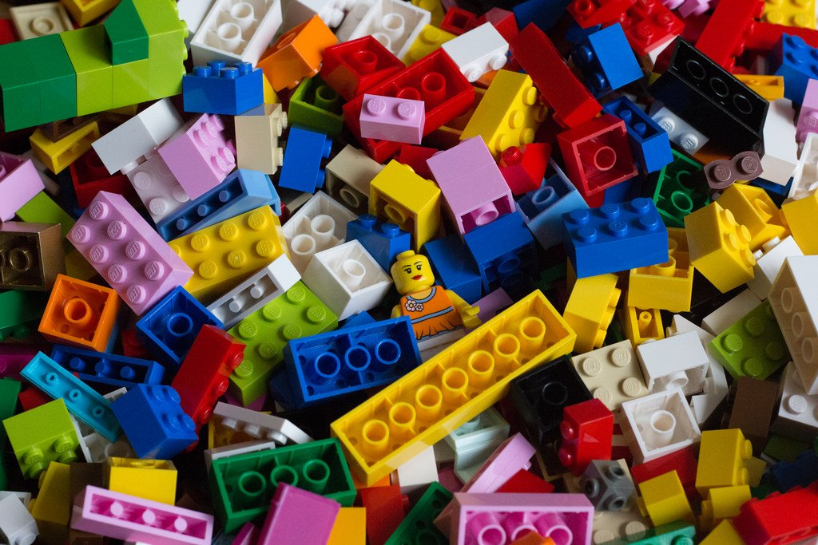
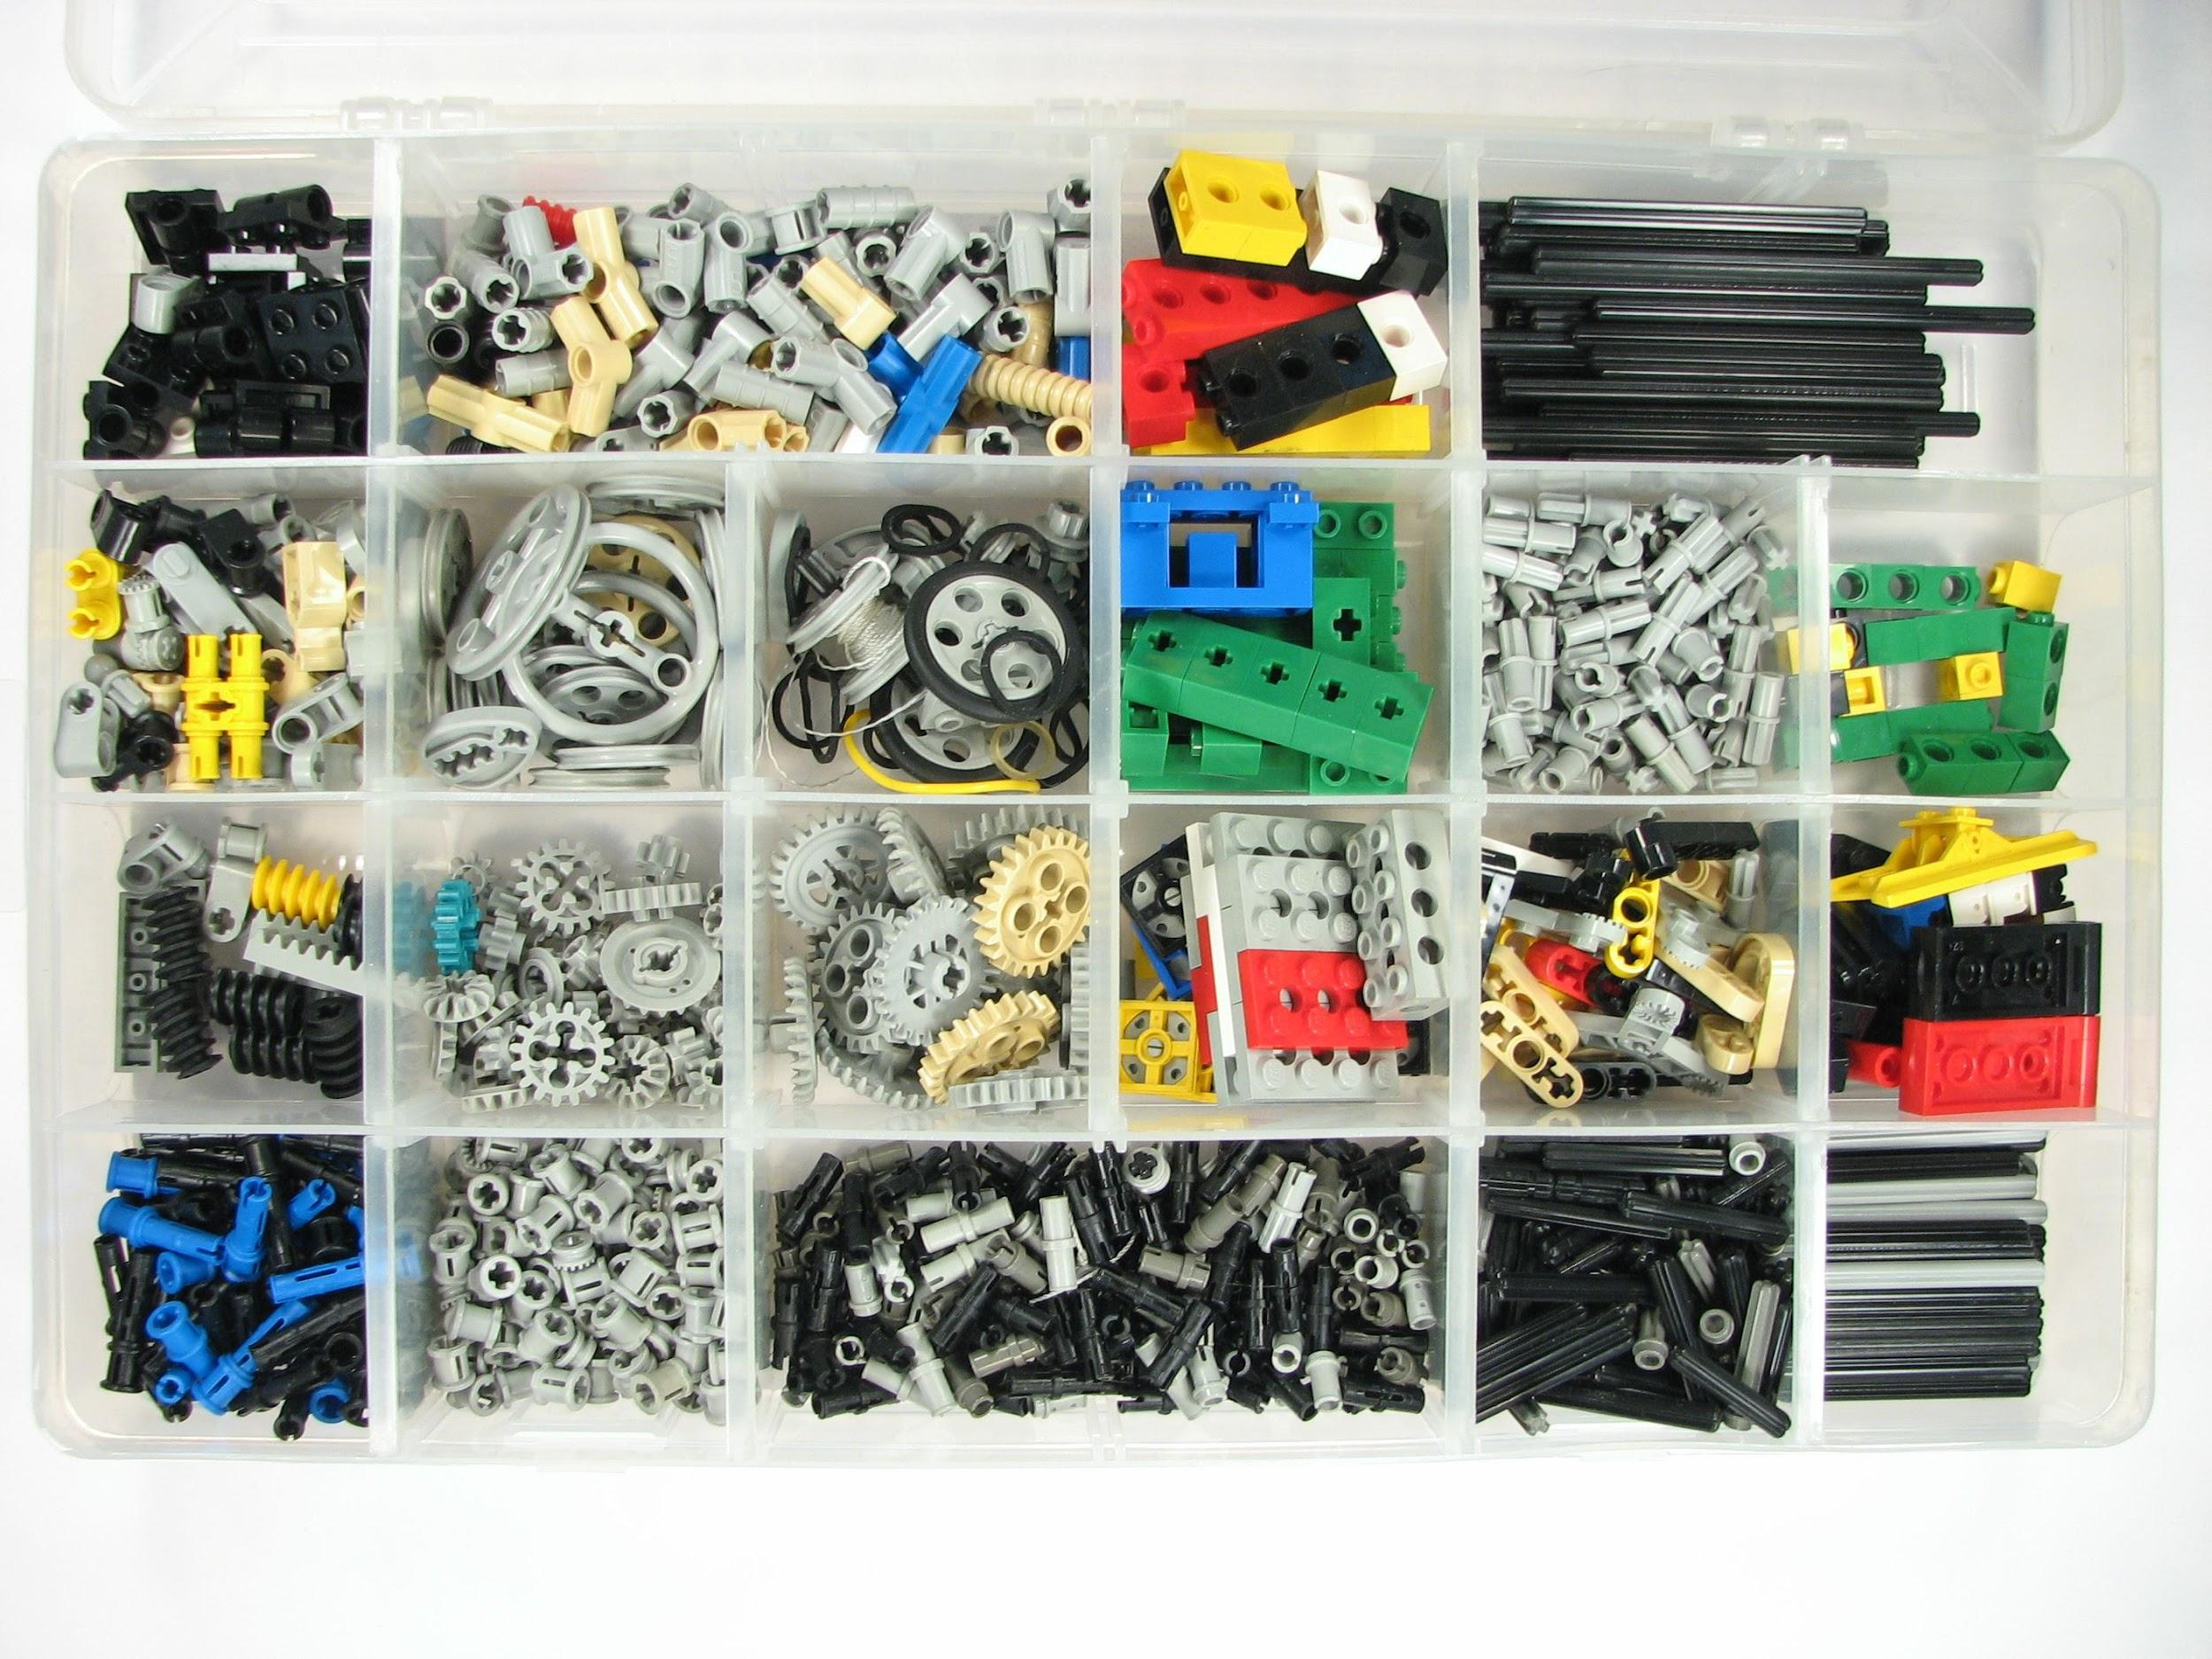
DDI Lifecycle
DDI Lifecycle Structuration
Variable Scheme
Question Scheme

Slide 27
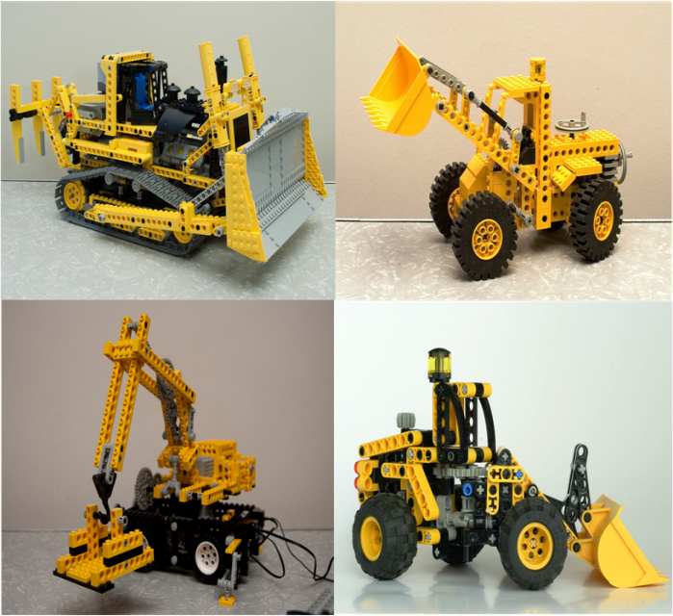
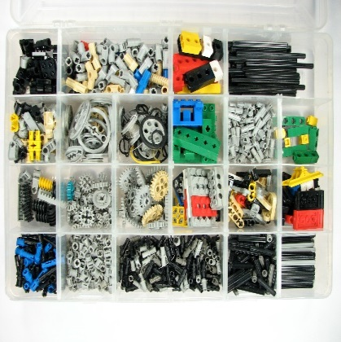
Reusable items in Lifecycle
Metadata structured by DDI Lifecycle standard
Metadata specified by DDI Lifecycle standard

Slide 28
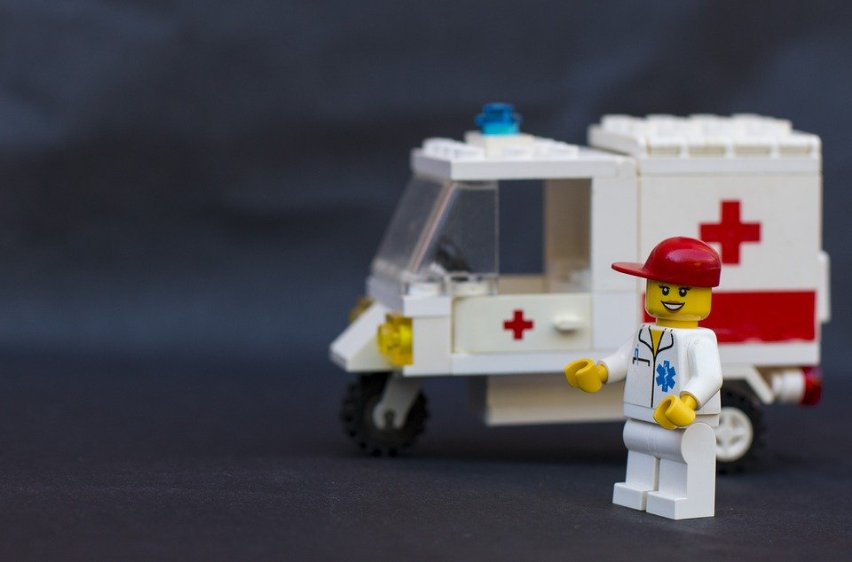
DDI CDI:
handles new data structures and domains

Slide 29
And Now …..
Notes:
We will learn more about DDI Codebook briefly.
I thought it was important to make sure you understood DDI before trying to explain one of the DDI products because if you don’t understand DDI, you won’t really understand what the product does.
I have talked about enough high level material and it is time to get down to more granular information.

Slide 30
DDI Codebook
A structure facilitating the production of machine-readable codebooks and data dictionaries.
Built to emulate a physical codebook,
that is, to catalog a dataset, to describe a single study or a single round or wave in a repeated study.
The latest version of DDI-Codebook in version 2.5.

Slide 31
DDI Codebook …
Relatively straight forward
Sections
Document Description
Study Description
Data Files Description
Variable Description
Other Study Related Materials
Notes:
Document description – describes the actual document that you are putting together to describe the survey or study
Study description – describes the actual survey that will be put into the data portal – many of the metadata tags in this section are the same as the ones in the first section
Data files description – exactly what it says
Variable description – any and all information there is about each and every variable in the study – from the question text (including any pre questions), the variable label, all the values and the associated labels for that particular variable, the population and any additional notes, for example, instructions for the interviewer.
Other study related materials – questionnaires, user guides, codebooks, …

Slide 32
Best Practices Document
Started with the DDI Alliance technical document
Made it human readable
Updated last year (2019)
Used when marking up in ODESI
Uses the Nesstar platform
Uses lots of examples
Great for training purposes
Notes:
Minor revisions over the years
Written when we developed Odesi - Ontario data portal
Lots of examples from different survey producers were important to enable those doing the mark-up to choose the example that suited their purposes the best

Slide 33
Notes:
- 98 pages
- Includes all the DDI tags you might want to use - an explanation of each tag – in words you can understand, and multiple examples to illustrate what information is expected in the tag
173 possible tags – might not use them all – that is fine!
https://library.carleton.ca/sites/default/files/help/data-centre/BPDv3-1-2019-01-28.pdf
This is also in French

Slide 34
ODESI BPD Example
Notes:
Section 1 = Document Description section

Slide 35
And Now …..
Notes:
That is it for me.
So now we will learn more about DDI Lifecycle from Benjamin.

Slide 36
What can DDI do for you? An introduction to the DDI
Part 2
Monday November 30, 2020
Benjamin Beuster - NSD - Norwegian Centre for Research Data
Jane Fry – Carleton University
License: Creative Commons Attribution 4.0 International (CC BY 4.0)

Slide 37
Outline
What is the DDI Lifecycle?
Other topics:
Identification and versioning
Variable cascade and lineage
Questionnaire Design
An Introduction to the DDI (EDDI 2020)

Slide 38
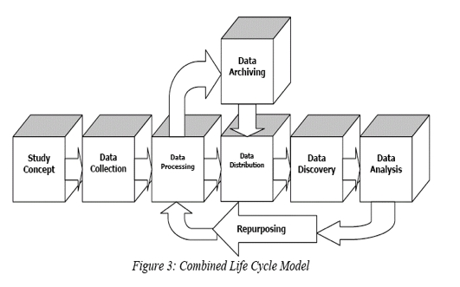
DDI-L covers the data lifecycle from
conceptualization to instrument design,
data collection, archiving and publication
An Introduction to the DDI (EDDI 2020)

Slide 39
DDI-Lifecycle
DDI-Lifecycle is a rich xml-based specification
Facilitates reuse of metadata components across the data lifecycle
Facilitates documentation of changes over time
The current version of DDI-Lifecycle is version 3.3
An Introduction to the DDI (EDDI 2020)

Slide 40
Reusable items in Lifecycle
Metadata structured by DDI Lifecycle standard
Metadata specified by DDI Lifecycle standard
Variable Scheme
Question Scheme

Slide 41
DDI - Lifecycle
Identification and Versioning
An Introduction to the DDI (EDDI 2020)

Slide 42
DDI Items – what are they?
Typed items (elements or objects) as defined by the DDI standard
Can be managed independently
Examples include:
Questions, Classifications, Concepts, Organizations, Variables
An Introduction to the DDI (EDDI 2020)

Slide 43
Identification of DDI items
DDI items are identified by the combination of three parts
Agency identifier
Item identifier
Item version
Agency identifiers can be obtained for free from the DDI Registry
http://registry.ddialliance.org
Necessary for resolution of DDI items in a distributed environment
An Introduction to the DDI (EDDI 2020)
Notes:
URN (Uniform Resource Name)

Slide 44
Versioning
Version 1
Version 2
Property | Value
Agency | int.example
ID | abc123
Version | 1
Property | Value
Agency | int.example
ID | abc123
Version | 2
What is yore name?
What is your name?
[_______________] Enter your first and last name

Slide 45
Benefits of identifying DDI items
Manage items separately from each other
Reuse a specific version of a DDI item
Track provenance between items
Track changes to items over time
An Introduction to the DDI (EDDI 2020)

Slide 46
Reuse of DDI items
The same item can be referenced from multiple location
One definition, used in multiple relationships.
Example: The same question is used in multiple questionnaires
References are to a specific version of an item
An Introduction to the DDI (EDDI 2020)

Slide 47
Reuse of DDI items
Example: A managed scale representation can for example be reused by reference by many different question items
Q1, V3
Q2, V1
V1
Q3, V4
People in general should care more about the environment
Climate change is caused by human activity alone
There is nothing I can do to prevent global temperature rise
V1
Strongly agree Strongly disagree
0 1 2 3 4 5 6 7 8 9 10

Slide 48
Versioning up the metadata tree
Example: A category version change may trigger a version change in the code list(s) referencing it
Category
Liberal Democrat
V1
Liberal Democrats
V2
CodeList
1 Conservative
2 Labour
3 Liberal Democrat
4 Scottish National Party
5 Plaid Cymru
6 Green Party
V1
1 Conservative
2 Labour
3 Liberal Democrats
4 Scottish National Party
5 Plaid Cymru
6 Green Party
V2

Slide 49
CL1 V1
code | category
0 | Not completed ISCED level 1
113 | ISCED 1, completed primary education
129 | Vocational ISCED 2C < 2 years, no access ISCED 3
212 | General/pre-vocational ISCED 2A/2B, access ISCED 3 vocational
213 | General ISCED 2A, access ISCED 3A general/all 3
221 | Vocational ISCED 2C >= 2 years, no access ISCED 3
222 | Vocational ISCED 2A/B, access ISCED 3 vocational
223 | Vocational ISCED 2, access ISCED 3 general/all
229 | Vocational Isced 3C < 2 years, no access ISCED 5
311 | General ISCED 3 >=2 years, no access ISCED 5
312 | General ISCED 3A/3B, access ISCED 5B/lower tier 5A
313 | General ISCED 3A, access upper tier ISCED 5A/all 5
321 | Vocational ISCED 3C >=2 years, no access ISCED 5
322 | Vocational ISCED 3A, access ISCED 5B/lower tier 5A
323 | Vocational ISCED 3A, access upper tier ISCED 5A/all 5
412 | General ISCED 4A/4B, access ISCED 5B/lower tier 5A
413 | General ISCED 4A, access upper tier ISCED 5A/all 5
421 | ISCED 4 programmes without access ISCED 5
422 | Vocational ISCED 4A/4B, access ISCED 5B/lower tier 5A
423 | Vocational ISCED 4A, access upper tier ISCED 5A/all 5
510 | ISCED 5A short, intermediate/academic/general tertiary below bachelor
520 | ISCED 5B short, advanced vocational education
610 | ISCED 5A medium, bachelor/equivalent fro lower tier tertiary
620 | ISCED 5A medium, bachelor/equivalent from upper/single tier tertiary
710 | ISCED 5A long,master/equivalent from upper/single tier tertiary
720 | ISCED 5A long, master/equivalent from upper/single tier tertiary
800 | ISCED 6 Doctoral degree
Track provenance between items
Example: Two related code lists with education categories. The short list is based on the long list. The short list has a based-on reference to the long list.
This allows to track the relationship between the two related code lists.
CL2 V1
code | category
1 | ES-ISCED I, less than lower secondary
2 | ES-ISCED II, lower secondary
3 | ES-ISCED IIIb, lower tier upper secondary
4 | ES-ISCED IIIa, upper tier upper secondary
5 | ES-ISCED IV, advanced vocational, sub-degree
6 | ES-ISCED V1, lower tertiary education, BA level
7 | ES-ISCED V2, higher tertiary education, >= MA level

Slide 50
DDI- Variable cascade
and lineage
An Introduction to the DDI (EDDI 2020)
Notes:
The basis of the DDI- Variable harmonisation and lineage in DDI-Lifecycle, the VariableCascade has been developed in connection with the DDI4 development and is included in DDI-Lifecycle from version 3.2 on. The slides on lineage apply to DDI-Lifecycle

Slide 51
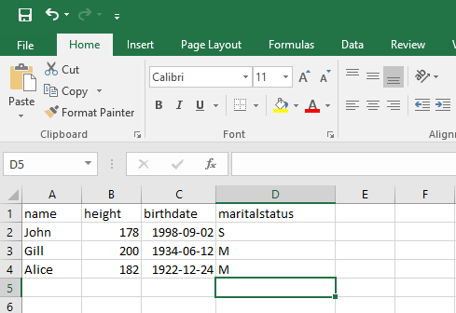
An Introduction to the DDI (EDDI 2020)
Notes:
What is a variable In DDI?
We will start to look at a small example dataset in excel

Slide 52
Example: dataset1
name | height | birthdate | maritalstatus
John | 178 | 1998-09-02 | S
Gill | 200 | 1934-06-12 | M
Alice | 182 | 1922-12-24 | M
An Introduction to the DDI (EDDI 2020)
Notes:
The data is devdied into columns where each represent a recorded value.
The whole purpose is to tie the variables together which are measuring a comparable topic.
Should we list what other domain use to describe a variable e.g. column in excel, relational database, attribute in object-oriented programing etc.
Start with a table of data- a variable is a column of data.
When people are approaching DDI they think of data as records of data
Are we missing info unless we explain why we have a rectangular file? How do you say that each row is related to the same column? Are we making an assumption– show an example and explain that we asked each people there marital status each row is a person.
We can visualise this as a table
Discuss as item type level in relation to other items rather than details about each.
Repeated measures in a column (not associated these measures with anything yet)

Slide 53
Different variable representation types
text | numeric | date | code
name | height | birthdate | maritalstatus
John | 178 | 1998-09-02 | S
Gill | 200 | 1934-06-12 | M
Alice | 182 | 1922-12-24 | M
An Introduction to the DDI (EDDI 2020)
Notes:
The variables have three obviously different types- text, numbers, dates and codes.
There are several more types, but in the following examples of a variable cascade we will use code, text and numeric

Slide 54
Variable with code representation
name | height | birthdate | maritalstatus
John | 178 | 1998-09-02 | S
Gill | 200 | 1934-06-12 | M
Alice | 182 | 1922-12-24 | M
An Introduction to the DDI (EDDI 2020)
Notes:
Maritalstatus have a coded representation

Slide 55
Variable - code representation
maritalstatus codes
code | category
S | Single
M | Married
maritalstatus (variable)
An Introduction to the DDI (EDDI 2020)
Notes:
maritalstatus point to a code list with the enumerated value.
The variable have a code list:
S = Single
M = Married

Slide 56
Three similar datasets
dataset1
name | height | birthdate | maritalstatus
John | 178 | 1998-09-02 | S
Gill | 200 | 1934-06-12 | M
Alice | 182 | 1922-12-24 | M
dataset2
firstname | personheight | dateofbirth | maritalstatus2010
Bob | 70 | 1995-09-02 | S
Lars | 76 | 1954-06-21 | M
Gerald | 66 | 1972-11-23 | S
dataset3
firstname | imperialheight | dateofbirth | maritalstatus2018
Lisa | 69 | 1995-09-02 | S
Bart | 75 | 1954-06-21 | M
Homer | 68 | 1972-11-23 | D
Notes:
Three datasets with similar variables.
Note: some variable names are different and the values are a bit different

Slide 57
Three similar datasets -
code representation
dataset1
name | height | birthdate | maritalstatus
John | 178 | 1998-09-02 | S
Gill | 200 | 1934-06-12 | M
Alice | 182 | 1922-12-24 | M
dataset2
firstname | personheight | dateofbirth | maritalstatus2010
Bob | 70 | 1995-09-02 | S
Lars | 76 | 1954-06-21 | M
Gerald | 66 | 1972-11-23 | S
dataset3
firstname | imperialheight | dateofbirth | maritalstatus2018
Lisa | 69 | 1995-09-02 | S
Bart | 75 | 1954-06-21 | M
Homer | 68 | 1972-11-23 | D
Notes:
Two datasets sharing same code list and the third have a new code list.
They are related in some way, but how do we relate these together- the variable cascade helps us do this.

Slide 58
Variables re-using sets of codes
maritalstatus (variable)
maritalstatus codes
code | category
S | Single
M | Married
maritalstatus2010 (variable)
maritalstatusplus codes
code | category
S | Single
M | Married
D | Divorced
maritalstatus2018 (variable)
Notes:
The first two datasets share the same codes while the third have its own sets of codes

Slide 59
Documenting comparabilities among variables
maritalstatus (conceptual variable)
Conceptual variable The most
generic way to describe a variable
Represented variable
Describes how a variable is measured
maritalstatus (represented variable)
maritalstatusplus (represented variable)
Variable
A column in a dataset
maritalstatus (variable)
maritalstatus2010 (variable)
maritalstatus2018 (variable)
Notes:
What is variable cascade?
Three Different (distinct) sets of data with a different variables all measuring marriage status.
Represented variables link variables which are directly comparable.
Same representation of the value domain. It doesn’t care about the question asked- only the value domain.
The represented variable is a way to measure marriage and so links to the marriage conceptual variable.
Represented variable means that they are not directly comparable but can be made to be comparable.
The third dataset has a different code list (i.e. value domain) and so it needs a new representative variable which then links to the conceptual variable.
Concept variable defines a measure without defining the measurement.
Value domain = Variable representation in DDI

Slide 60
Benefits of the variable cascade structure
Allows comparison of variables across datasets
Facilitates variables harmonization
An Introduction to the DDI (EDDI 2020)
Notes:
Benefits
Comparability and provenance.
Lineage of the data/provenance
Identify comparable data
Compare how the response values have changed over time or over different sources
Used to manage to change and comparability
Supports people working on harmonisation (gives you the structure to describe the variables and decide whether you can harmonise them or not)
Useful resources
Daniel Gillman EDDI 2017: The DDI-4 Variable Cascade and Datum-Centered Approach
Colectica docs site - https://docs.colectica.com/designer/manage-content/data/harmonize-variables/
Questions/answers
What level do we publish?
it depends on how you want to display the datasets.
All the variables could have the same variable name, but in DDI they will have a different identifier. It is up to you which you see.
We should always have the conceptual and represented in place, even if there is no change in the code value.
DDI separates the conceptual variables and representative variable is so that someone can query the relationships without having to look at every variable and value domain which is time consuming and also not reliant on a machine- as it is shows that person has decided that these are comparable.
Should there always be a new variable for each data collection- can they be the same variable?
It depends on how you describe the dataset- there is lots more info about a dataset then just its type e.g. who it’s measured about e.g. universe. If you have different datasets the people/household changes. If you have new dataset then it is usually a new instance variable. Specific to a datasets as the it contains other metadata e.g. time of collection. If you publish data every quarter the variable instance will be different each time.
If there is only one dataset- whey would you use represented and conceptual variables- If you want people to re-use it or to use with other study’s data then it is valuable to including the represented and conceptual variable.
Ideal world- create a concept then create a question for that. Which is linked to the represented and conceptual variable. – questions to be discussed elsewhere.

Slide 61
Variable Lineage
Describes the origin of a variable
Relationship between concept, question and variable
Document derived variables and see how it has been computed
An Introduction to the DDI (EDDI 2020)

Slide 62
Variable lineage
eisced (derived variable)
eisced
Highest level of education
(short)
edulvlb (variable)
edulvlb
Highest level of education
(long)
What is the highest... (question)
Educational attainment (sub-concept)
Education (concept)
Notes:
All three variables share the same text representation and is linked to the same represented variable

Slide 63
DDI-Lifecycle
Questionnaire Design
An Introduction to the DDI (EDDI 2020)

Slide 64
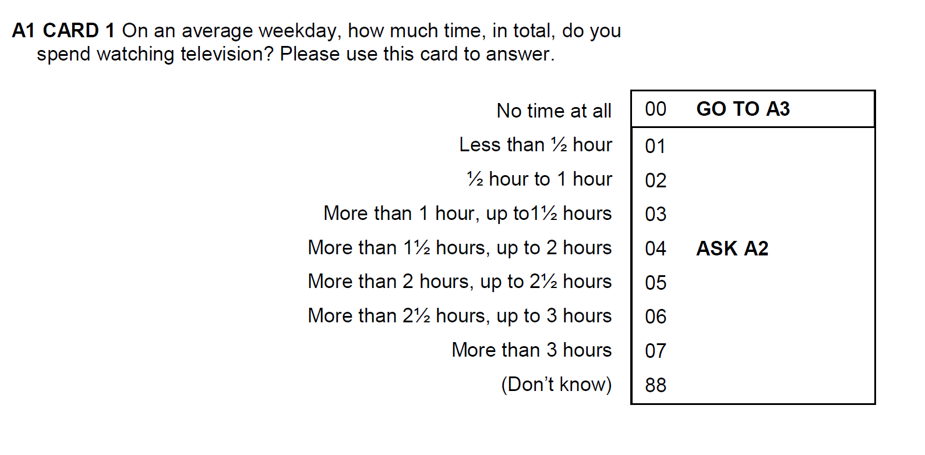
A question as in the questionnaire
Number/name in questionnaire
Instructions
Questionnaire flow
Question text
Code list, valid codes
Missing values list
Categories
Code values
Notes:
A question as in the questionnaire is composed of a set of components that usefully can be maintained separately.
The basics of a question is the QuestionItem in DDI that contains the more reusable parts of a question like the QuestionText and the ResponseDomain.
Instructions and instrument flow logic are less reusable components.
Response oprions, here a code list, can usefully be split into valid and missing values codelists, which allows them to be maintained and reused separately.
A CodeList consists of codes with a value and a category reference. Categories can be reused in many different response domains, as well as for variables.
A CodeList is one of several types of response domains in DDI. Others are ScaleDomain, NumericDomain, TextDomain, DateTime etc.

Slide 65
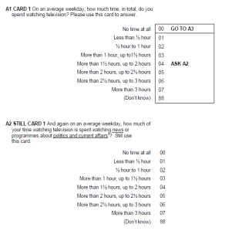
DDI Control Construct – basics for a computer based instrument
Question Construct
Sequence
Statement Item
Here are some questions about media use
Flow logic: If then else/loop etc.
If A1 = 1 – 7; 88

Slide 66
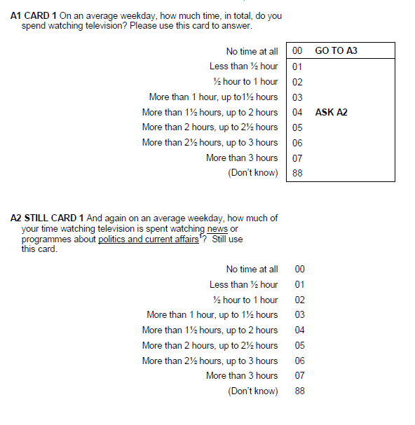
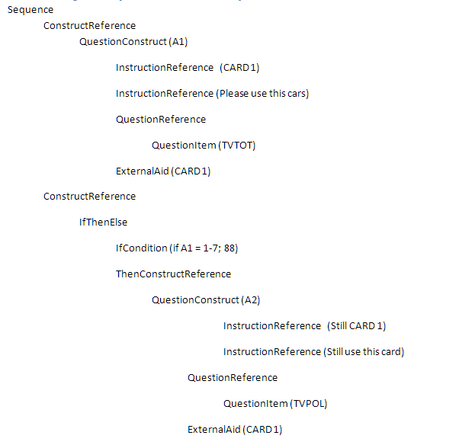
DDI Sequence – Question sequence and flow

Slide 67
Question Banks with DDI
An Introduction to the DDI (EDDI 2020)

Slide 68
DDI-L based Question Banks
Search survey questions (in different languages) from different Service Providers
Find survey questions for re-use
Access to related information like study and dataset documentation
An Introduction to the DDI (EDDI 2020)

Slide 69
DDI-L based Question Banks
CLOSER Discovery: Enables researchers to search questions from eight leading UK longitudinal studies. https://discovery.closer.ac.uk/
CESSDA Euro Question Bank: Contains survey questions of different datasets in different languages from the CESSDA Service Providers. https://euroquestionbank-dev.cessda.eu/
Other Question Bank tools: QDDT, Colectica Portal
An Introduction to the DDI (EDDI 2020)

Slide 70
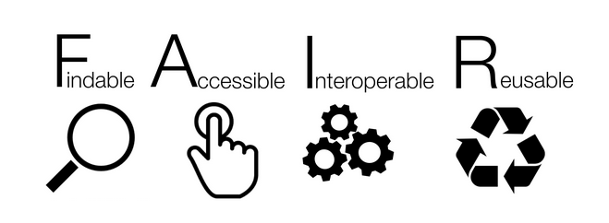
DDI – Making metadata FAIR
The FAIR principles:
https://www.go-fair.org/go-fair-initiative/
An Introduction to the DDI (EDDI 2020)
Notes:
The principles refer to three types of entities: data (or any digital object), metadata (information about that digital object), and infrastructure. For instance, principle F4 defines that both metadata and data are registered or indexed in a searchable resource (the infrastructure component).
This is an initiative of the stakeholders in the research process including academics, industry, funders and scholarly publishers to design and implement a set of principles that are called the FAIR Data Principles. FAIR data is all about reuse of data and emphasizes the ability of computers to find and use data. This involves data stewardship which is about proper collection, annotation and archiving of data but also preservation into the future of valuable digital assets. The product of good data management and stewardship are high quality digital publications that facilitate and simplify the ongoing process of discovery, evaluation and reuse. In this context, data is not only data in the conventional sense but also the algorithms, tools and workflows that led to the data.
In 2016, the ‘FAIR Guiding Principles for scientific data management and stewardship’ were published in Scientific Data. The authors intended to provide guidelines to improve the findability, accessibility, interoperability, and reuse of digital assets. The principles emphasise machine-actionability (i.e., the capacity of computational systems to find, access, interoperate, and reuse data with none or minimal human intervention) because humans increasingly rely on computational support to deal with data as a result of the increase in volume, complexity, and creation speed of data.
Findable The first step in (re)using data is to find them. Metadata and data should be easy to find for both humans and computers. Machine-readable metadata are essential for automatic discovery of datasets and services, so this is an essential component of the
Accessible Once the user finds the required data, she/he needs to know how can they be accessed, possibly including authentication and authorisation.
Interoperable The data usually need to be integrated with other data. In addition, the data need to interoperate with applications or workflows for analysis, storage, and processing.
Reusable The ultimate goal of FAIR is to optimise the reuse of data. To achieve this, metadata and data should be well-described so that they can be replicated and/or combined in different settings.

Slide 71
Thank you!
Contact information
Benjamin Beuster
Benjamin.Beuster@nsd.no
Jane Fry
Jane.fry@carleton.ca

Slide 72
References
DDI Alliance. Data Documentation Initiative. http://www.ddi-alliance.org/
Fry, J., Cooper, A., Mowers, S., & Carrington, C. (2019). “Best Practices Document: based on DDI 2.x, version 3.1”. https://bit.ly/3mhLmmH
Jacobs, J. (2006). “Evolution of Data Documentation”. Workshop “A Gentle Introduction to DDI: What’s in it for Me?” presented at IASSIST 2006.
Orten, H., Beuster, B., & Jääskelainen, T. (2019). «What can DDI do for you? AN introduction to the DDI. Presented at EDDI 2019. DOI: 10.5281/zenodo.3597192
Perry, A. & Fry, J. “Introduction to DDI: Basic Concepts and How to Develop Skills for Training Researchers” IASSIST 2019.
Schloss Dagstuhl, October 2014. “DDI Basics”. https://bit.ly/2ZkdoTu
Vardigan, M. & Wackerow, J. (2013). DDI – A metadata standard for the community. Paper presented at the North American Data Documentation Initiative Conference (NADDI) 2013. https://bit.ly/2J7RDTQ
Notes:
Evaluations!!

Slide 73
Accreditation
The following sections are authored by the
DDI Alliance Training Library Development Working Group:
Variable harmonization and lineage*
Question structures and reuse*
Identification and versioning*
Based on content developed at the DDI Train-the-Trainers Dagstuhl workshop 2018
*Adapted by Benjamin Beuster for presentation at EDDI2020

Slide 74
Acknowledgements
DDI Train-the-Trainers Dagstuhl workshop 2018 participants
AmberLeahey
Alexandre Mairot
Johan Fihn Marberg
Hayley Mills
Olof Olofsson
Hilde Orten
Anja Perry
Dan Smith
Wendy Thomas
Joachim Wackerow
Knut Wenzig
Alina Danciu
Guillaume Duffes
Adrian Dușa
Lauren Eickhorst
Dan Gillman
Arofan Gregory
Taras Günther
Lea Sztuk Haahr
Sanda Ionescu
Jon Johnson
Chifundo Kanjala
Kaia Kulla

Slide 75
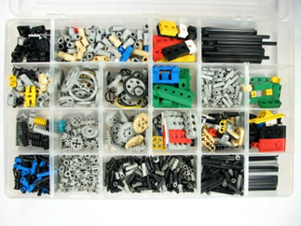
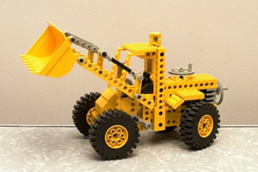
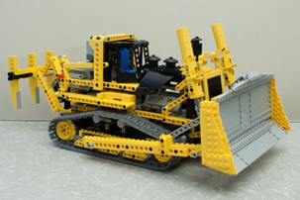
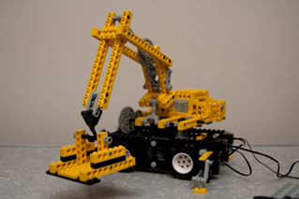
Picture credits
Steine unsortiert | woodleywonderworks, https://www.flickr.com/photos/wwworks/2472232245 (CC-BY)
Steine sortiert | Windell Oskay, https://www.flickr.com/photos/17425845@N00/2156888497 (CC-BY)
Bagger (3516880947_0f44a89c1c_z.jpg) | Stephen Edmonds: https://www.flickr.com/photos/popcorncx/3516880947/ (CC-BY-SA)
Bagger (lego-717196_960_720.png) | Desktopnexus.com: https://abstract.desktopnexus.com/wallpaper/2425074/
Bagger (3514881626_be3e87cc58_o.jpg) | Stephen Edmonds: https://www.flickr.com/photos/popcorncx/3514881626/ (CC-BY-SA)
Bagger (4485538519_d4ef5e284b_o.jpg) | Stephen Edmonds: https://www.flickr.com/photos/popcorncx/4485538519/in/album-72157617802609935/ (CC-BY-SA)
Construction (lego-516559_640.jpg) | Pixabay.com: https://pixabay.com/photos/lego-site-replica-building-blocks-516559/ Simplified Pixabay License
Health (health-2640352_640.jpg) | Pixabay.com: https://pixabay.com/photos/health-nurse-rescue-hospital-2640352/ Simplified Pixabay License
Duplo (lego-470158_640.jpg) | Pixabay.com: https://pixabay.com/photos/lego-logo-windows-duplo-470158/ Simplified Pixabay License

